Slide 1
Instructions for TUMonline How to find suitable courses?
Gabi Fried and Brigitta Schächterle/ International Office
Technical University Munich
Department of Sport and Health Sciences
Munich, 6th of April 2020

Slide 2
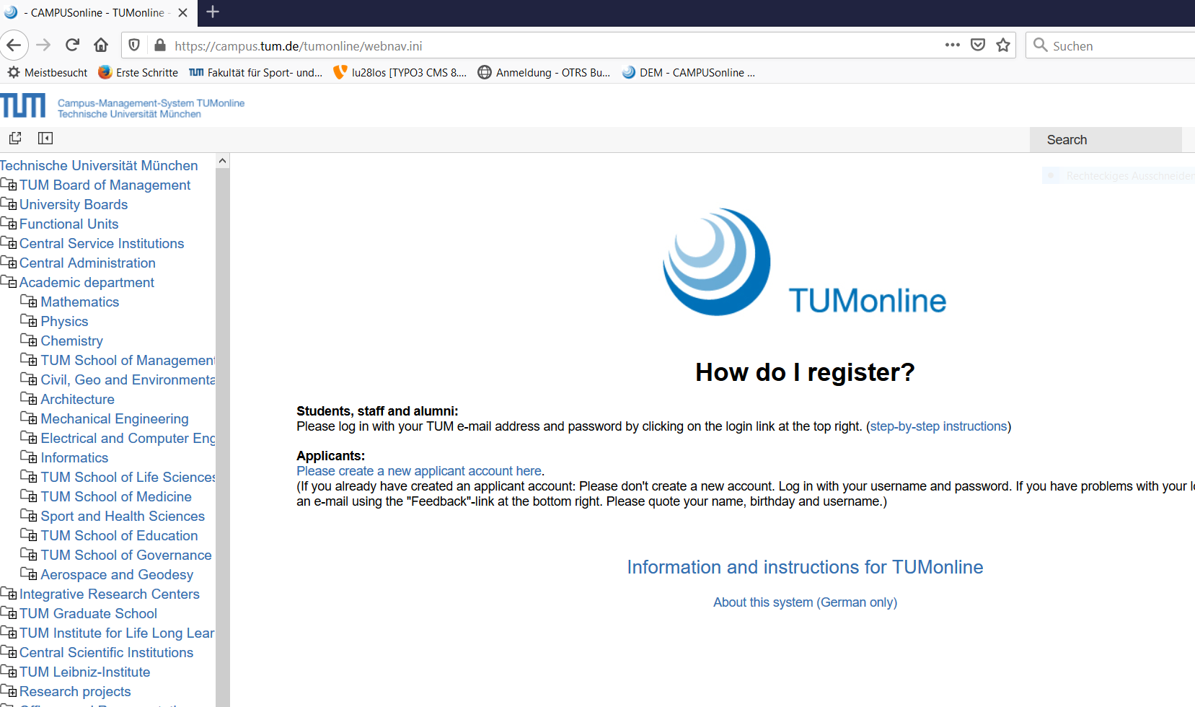
Go to page https://campus.tum.de/tumonline/webnav.ini and click on “Sport and Health Sciences”
in the Menu bar on the left.

Slide 3
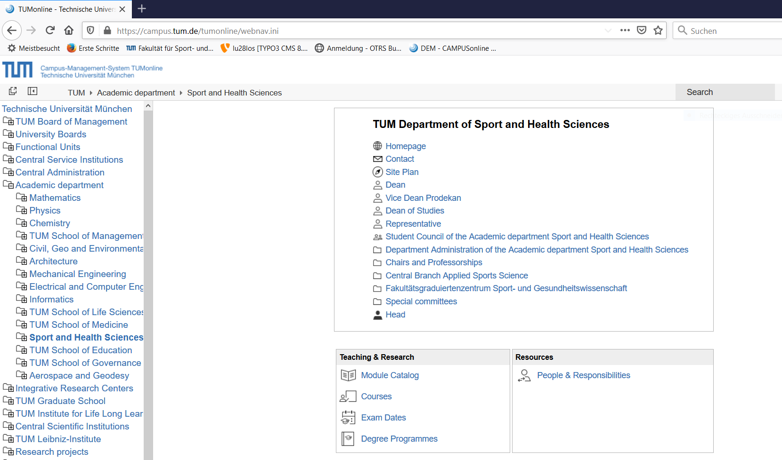
Now call up the page “Degree Programmes”.

Slide 4
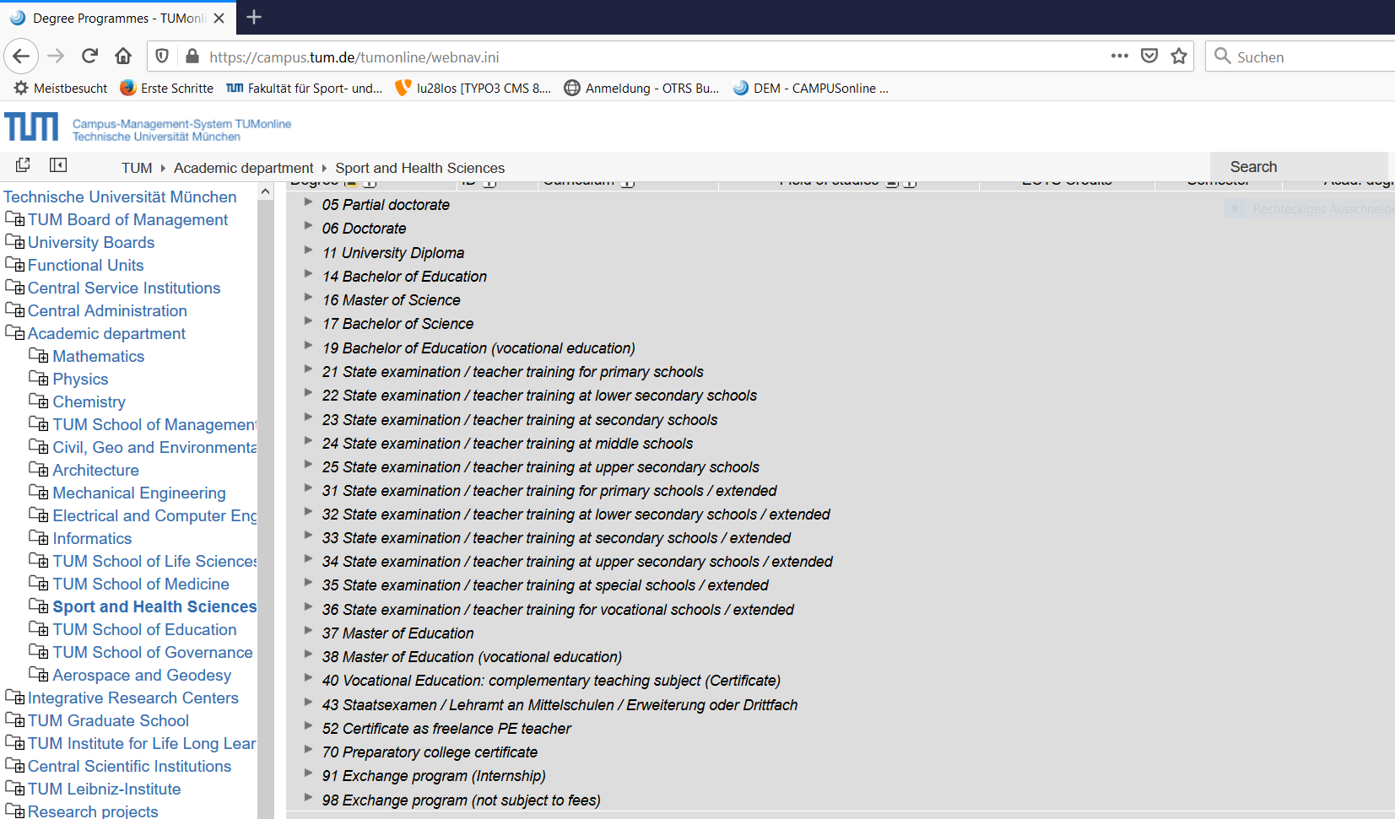
Select the "98 Exchange program" and click on the little arrow on the left.

Slide 5
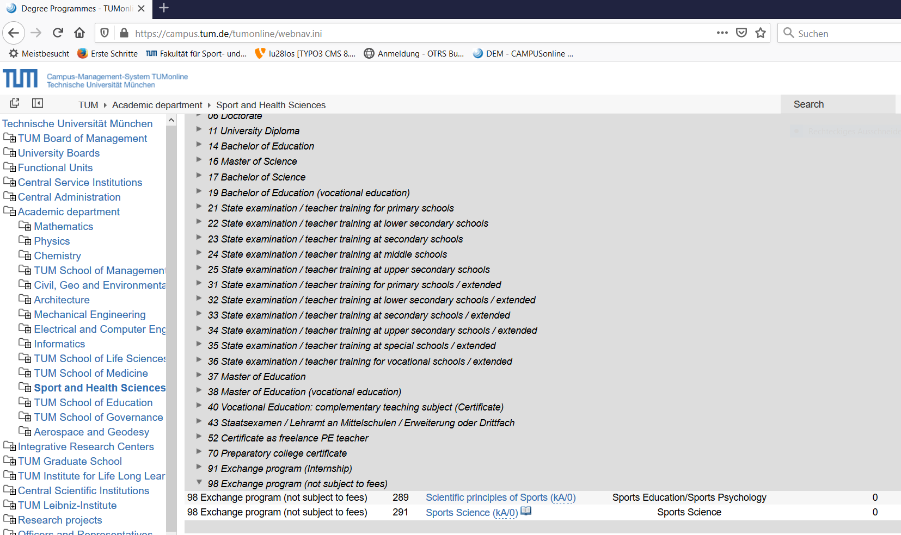
4. Select the study course “Sports Science".

Slide 6
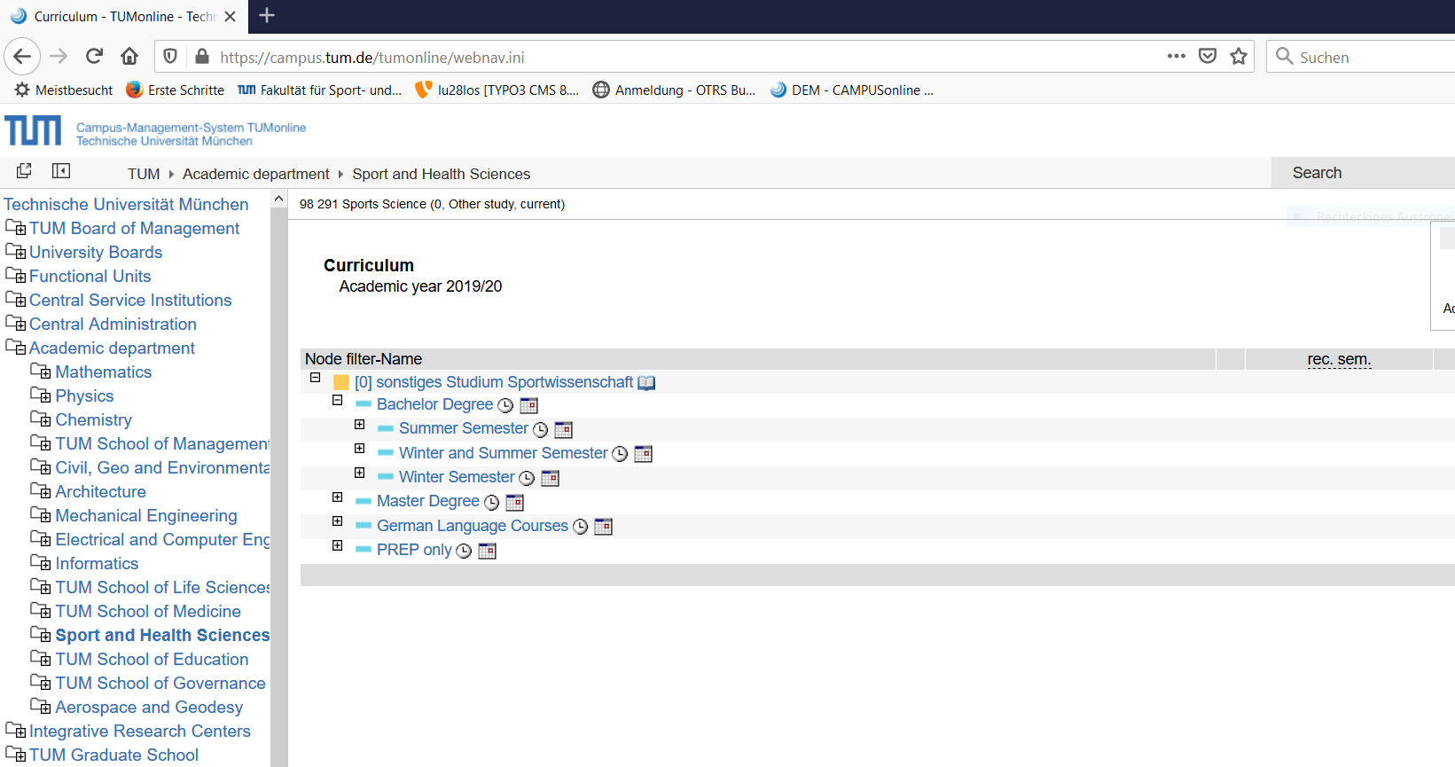
Bachelor:
Click on “Bachelor Degree”. Here you will find all the courses you can choose in summer and
winter semester, and the courses that are offered in both semesters.
Please note that courses from the PREP program can not be taken!
Courses Summer Semester
Courses Summer and Winter Semester
Courses Winter Semester

Slide 7
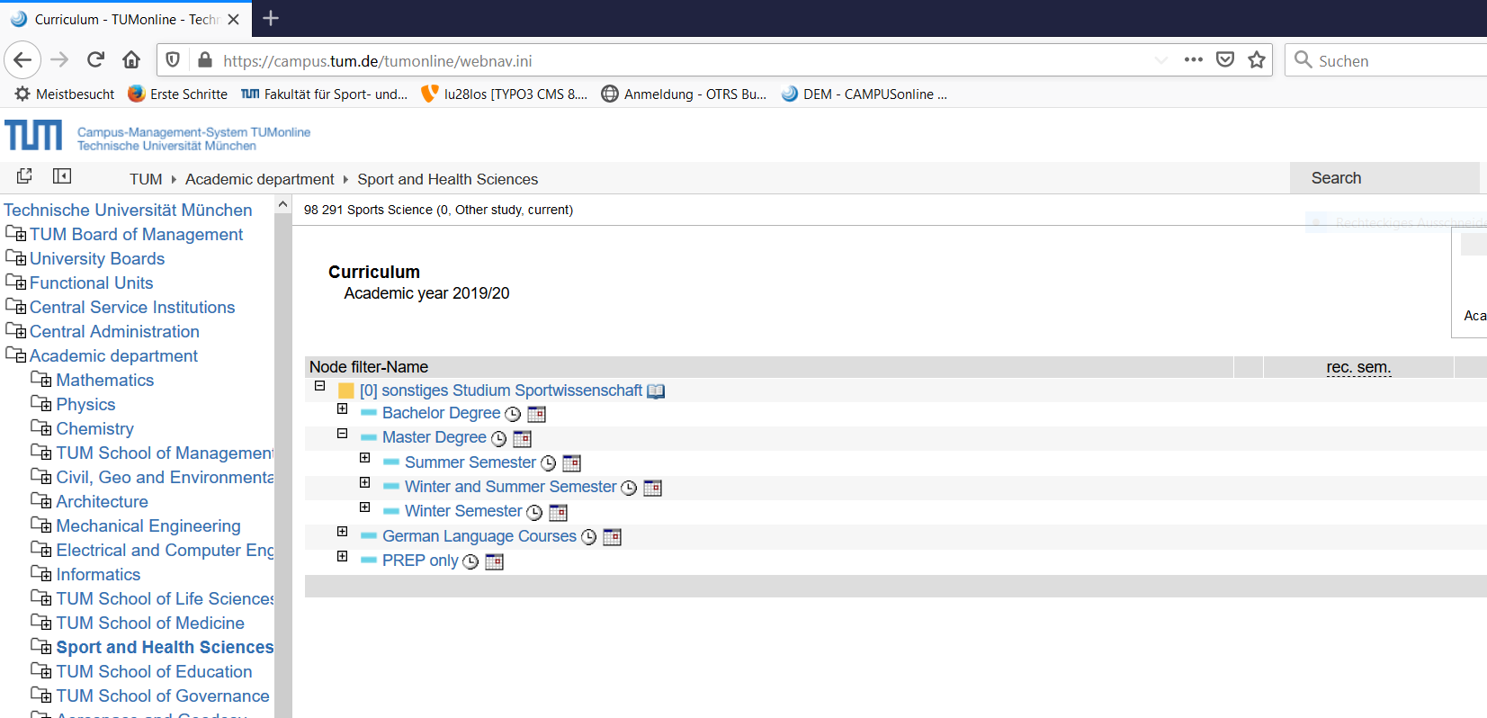
6. Master:
Click on “Master Degree”. Here you will find all the courses you can choose in summer and
winter Semester, and the courses that are offered in both semesters.
Please note that courses from the PREP program can not be taken!
Courses Summer Semester
Courses Summer and Winter Semester
Courses Winter Semester

Slide 8
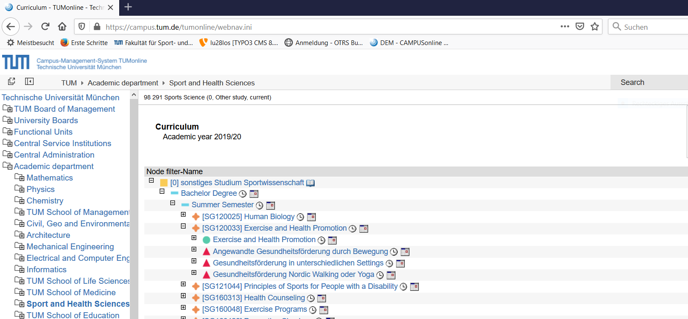
7. Courses:
When you open a module, you will find the corresponding courses and the examinations of
the module. Examinations are marked with a green dot, courses are marked with red arrows.
Please note that for passing the module and getting all ECTS-Points all courses of the module
must be taken! Please note the teaching language!
Name of the Module
Courses of the Module

